Slide 1
sampling
Slides adopted from Xing’s , CMU

Slide 2
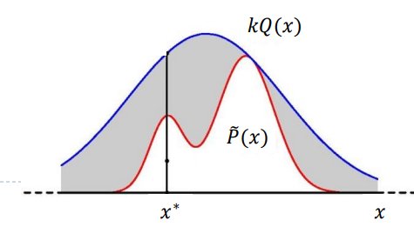
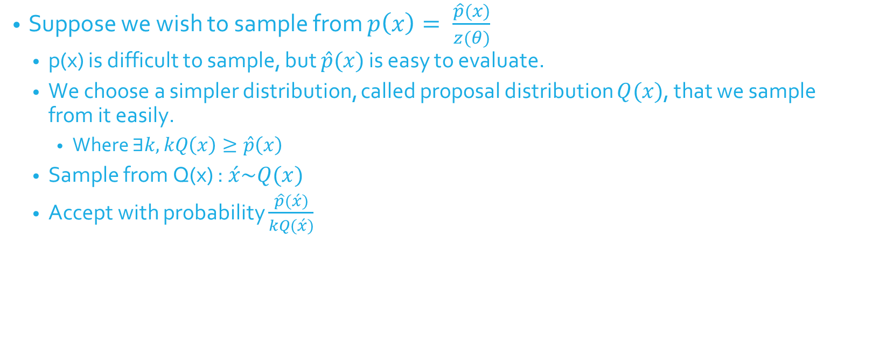
Rejection Sampling
Suppose we wish to sample from $p\left(x\right)= \frac{\hat{p}(x)}{z(θ)}$
p(x) is difficult to sample, but $\hat{p}(x)$ is easy to evaluate.
We choose a simpler distribution, called proposal distribution $Q(x)$, that we sample from it easily.
Where $∃k, kQ\left(x\right)≥\hat{p}\left(x\right)$
Sample from Q(x) : $\acute{x}\sim Q(x)$
Accept with probability $\frac{\hat{p}(\acute{x})}{kQ(\acute{x})}$

Slide 3

Rejection Sampling, contd
Correctness
$\frac{\frac{\acute{p}\left(x\right)}{kQ\left(x\right)}Q(x)}{\int{\frac{\acute{p}\left(x\right)}{kQ\left(x\right)}Q\left(x\right)dx}}=\frac{\acute{p}\left(x\right)}{\int{\acute{p}\left(x\right)dx}}=p(x)$
Acceptance probability
P(accept) = $\int{\frac{\acute{p}\left(x\right)}{kQ\left(x\right)}Q\left(x\right)dx=\frac{\int{\acute{p}(x)}dx}{k}}$

Slide 4
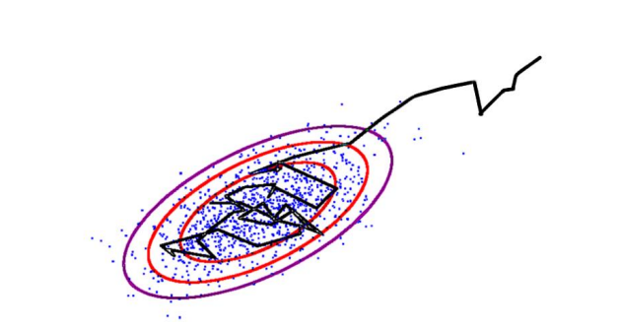

Metropolis-Hastings
Initialize starting state $x^{0}$, set t=0
Burn-in:while samples have not converged
$x=x^{t}$
Sample $\acute{x}\sim Q(\acute{x}|x)$
$A\left(\acute{x} | x\right)=min⁡(1, \frac{p\left(\acute{x}\right)Q\left(x | \acute{x}\right)}{p\left(x\right)Q\left(\acute{x} | x\right)})$
Sample $u \sim Uniform(0, 1)$
If $u<A\left(\acute{x} | x\right)$
$x^{t+1}=\acute{x}$
Else
$x^{t+1}=x^{t}$
t = t+1
For n=1…N
Draw samples from $Q\left(x | x^{n−1}\right)$ with acceptance probability $A(x|x^{n−1})$

Slide 5
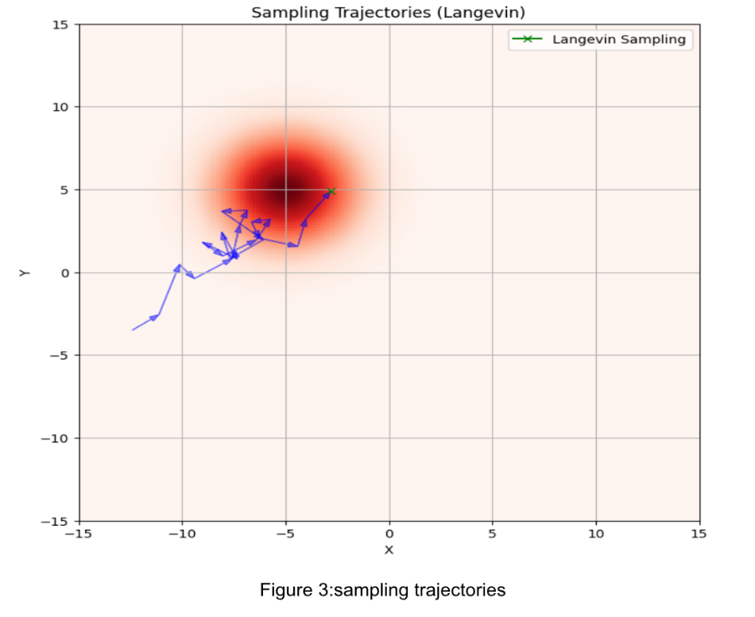

Langevin Dynamics
For any distribution $p_{θ}\left(x\right)$, consider having score function as $s_{θ}=∇_{x}\log{p_{θ}(x)}$
Let $π(x)$ be a prior distribution that is easy to sample from
$x^{0}=π(x)$
Repeat $x^{t+1}\sim x^{t}+ε×s_{θ}+\sqrt{2ε}×z^{t}$ for t=0, 1, 2, …, T-1, where $z^{t}\sim N(0, I)$.

